Slide 1
Contra costa college
Select Data & groups from integrated planning: tableau

Slide 2
Selection of data and groups
ESL is an entirely different kettle of fish
Access is misconstrued: we are an open access institution by definition
Assessment, orientation, educational plan are prescriptive inputs
Probation progress
Most assess into remedial classes
Milestones matter
Output is only real metric

Slide 3
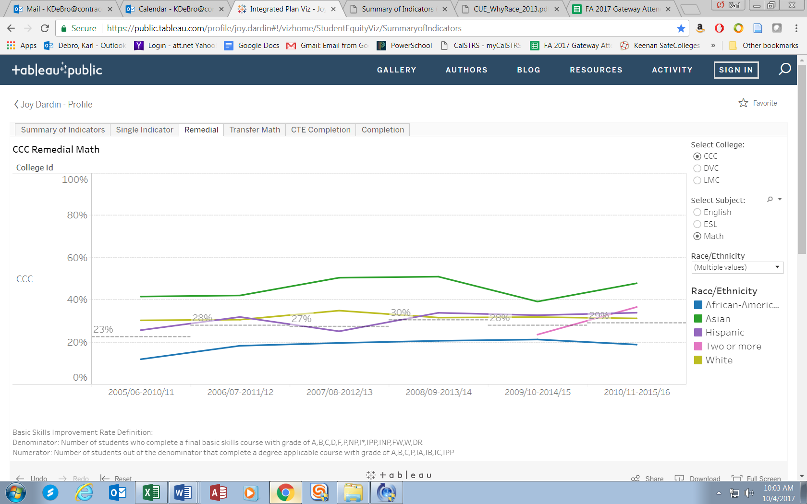

Slide 5
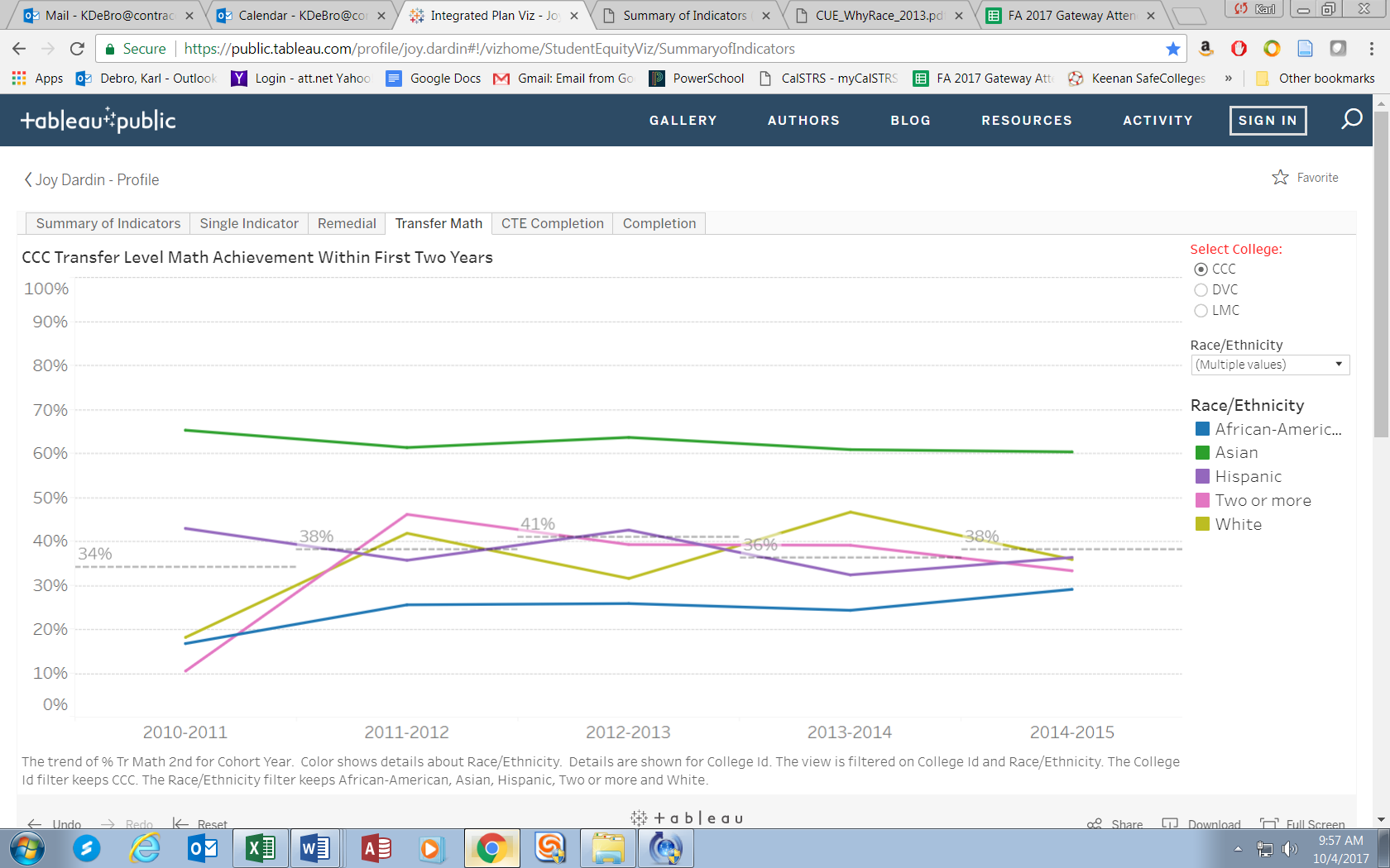

Slide 6
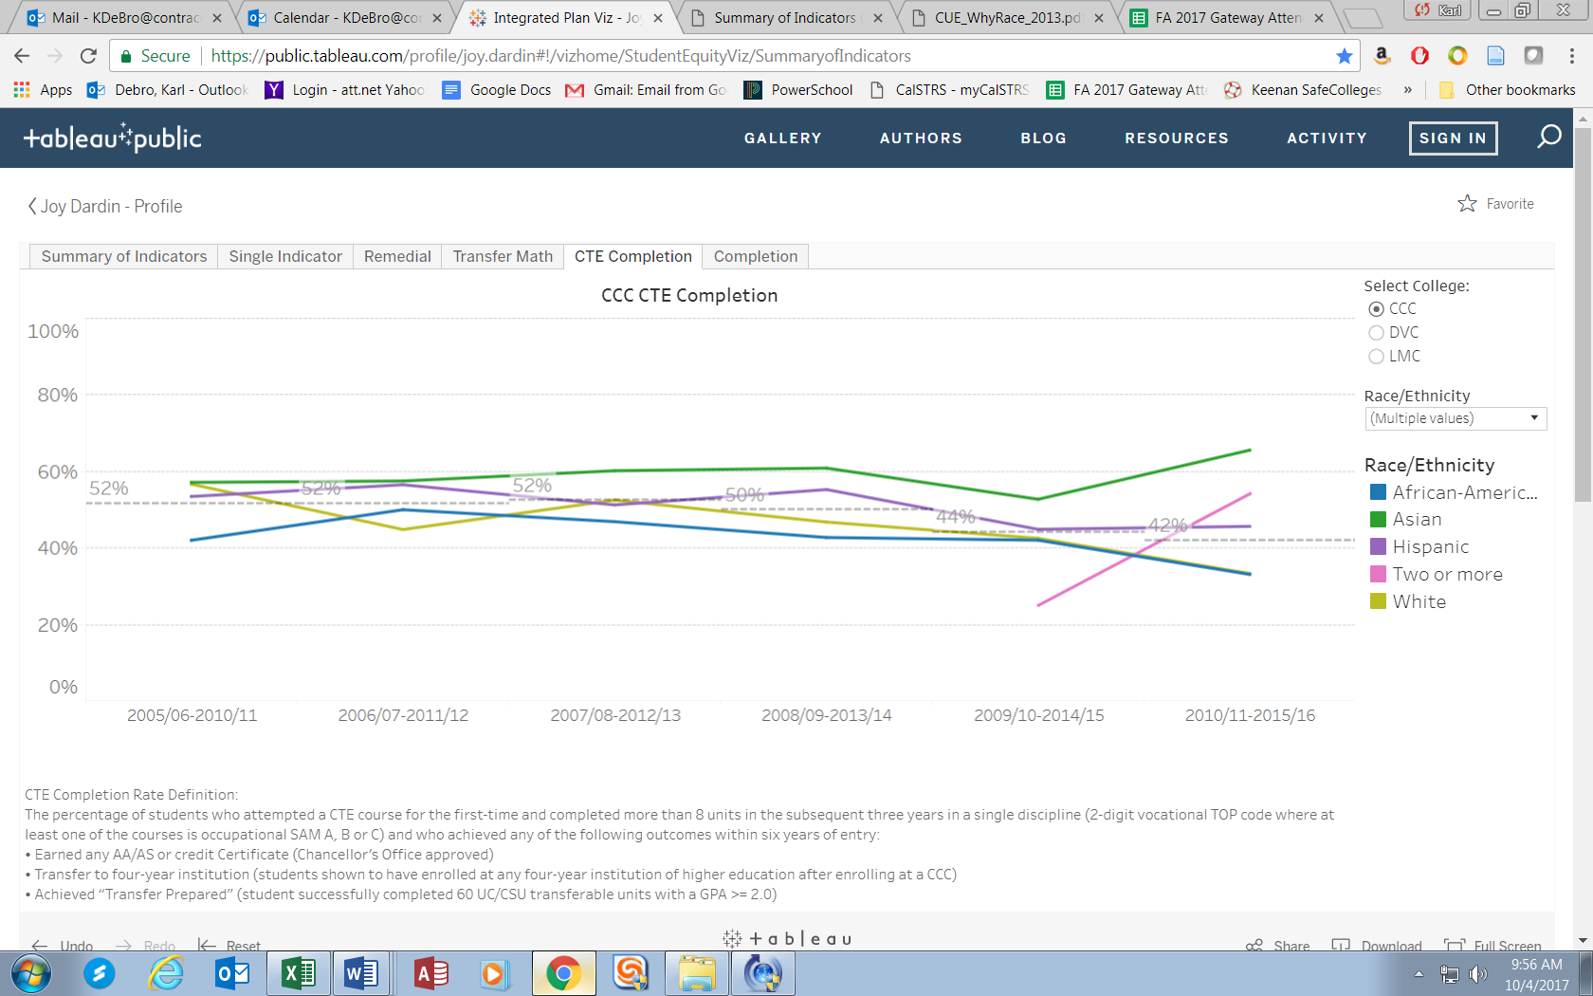

Slide 7
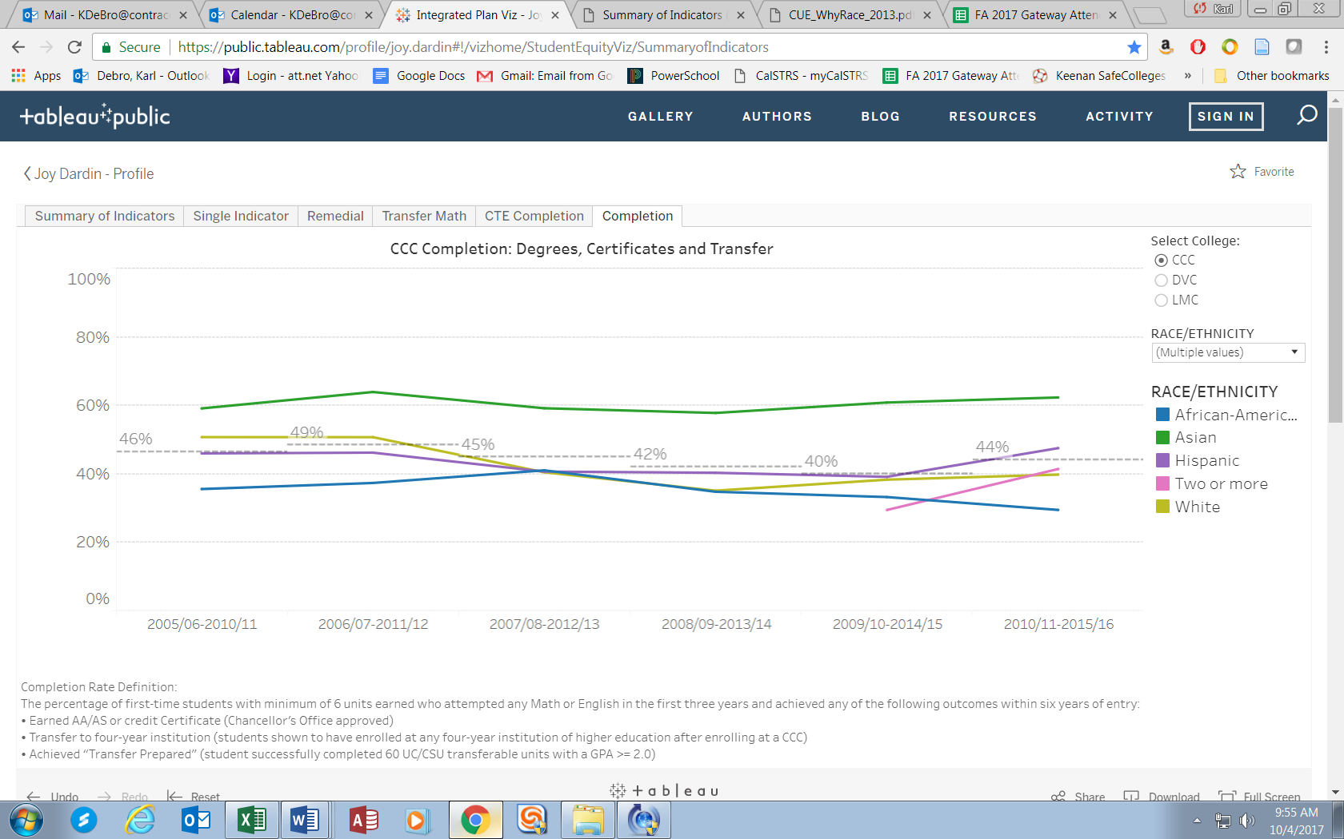

Slide 8
from all colleges
4cd data

Slide 9
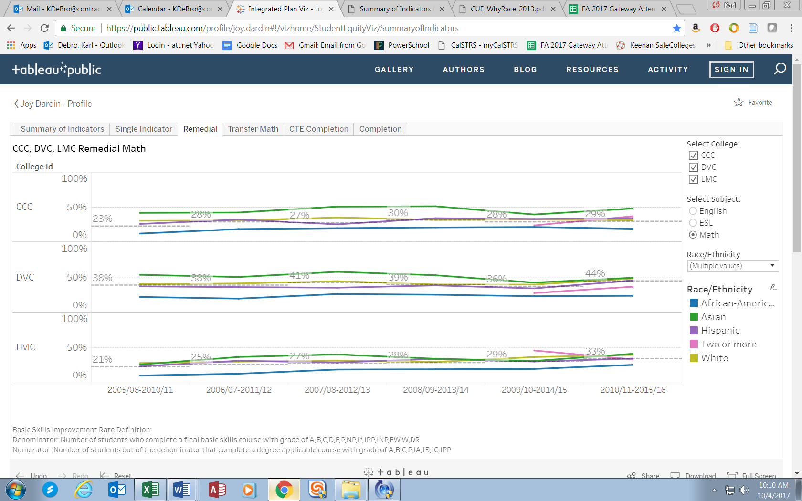

Slide 10
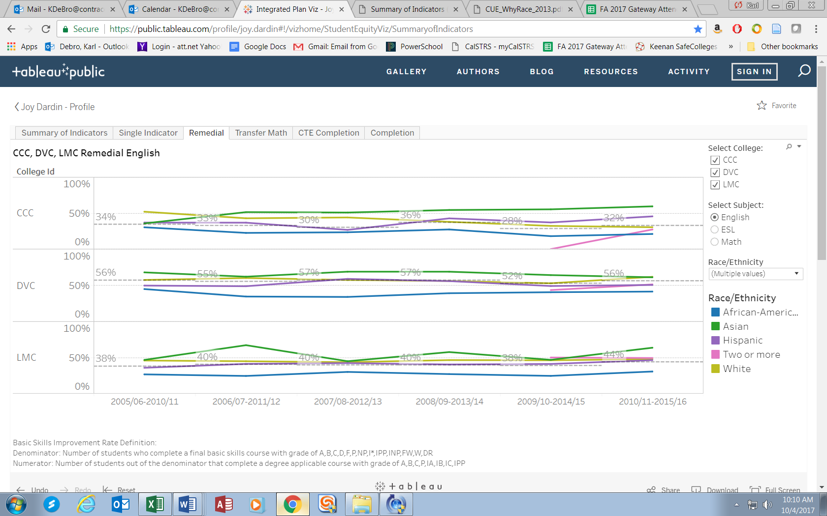

Slide 11
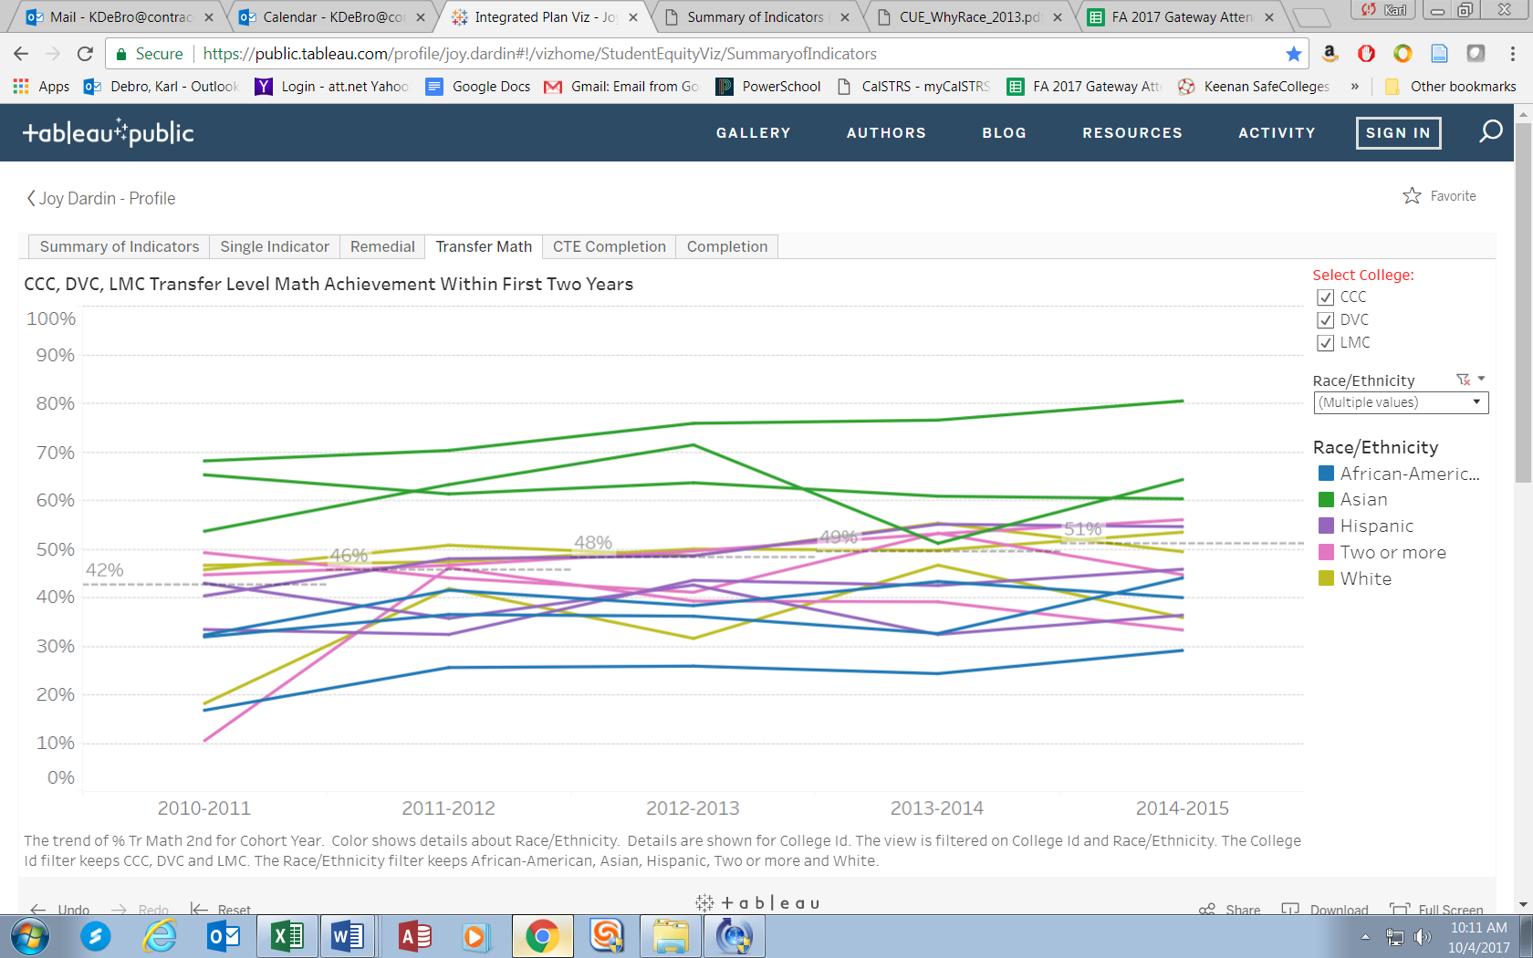

Slide 12
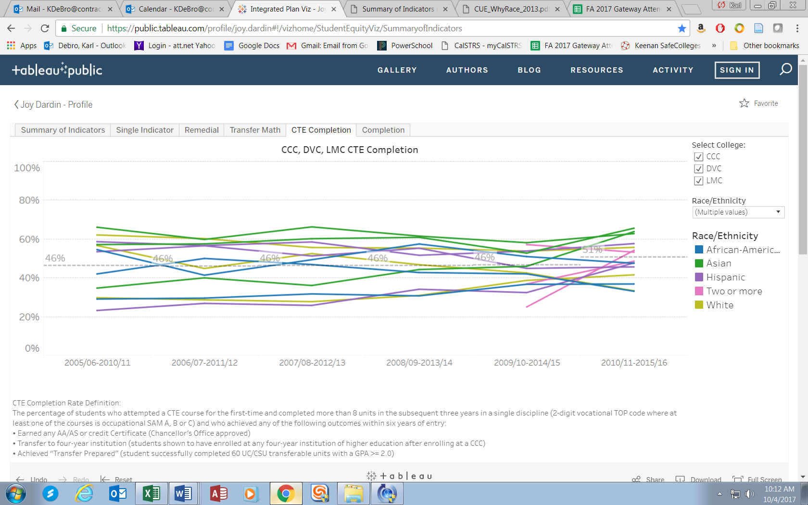

Slide 13
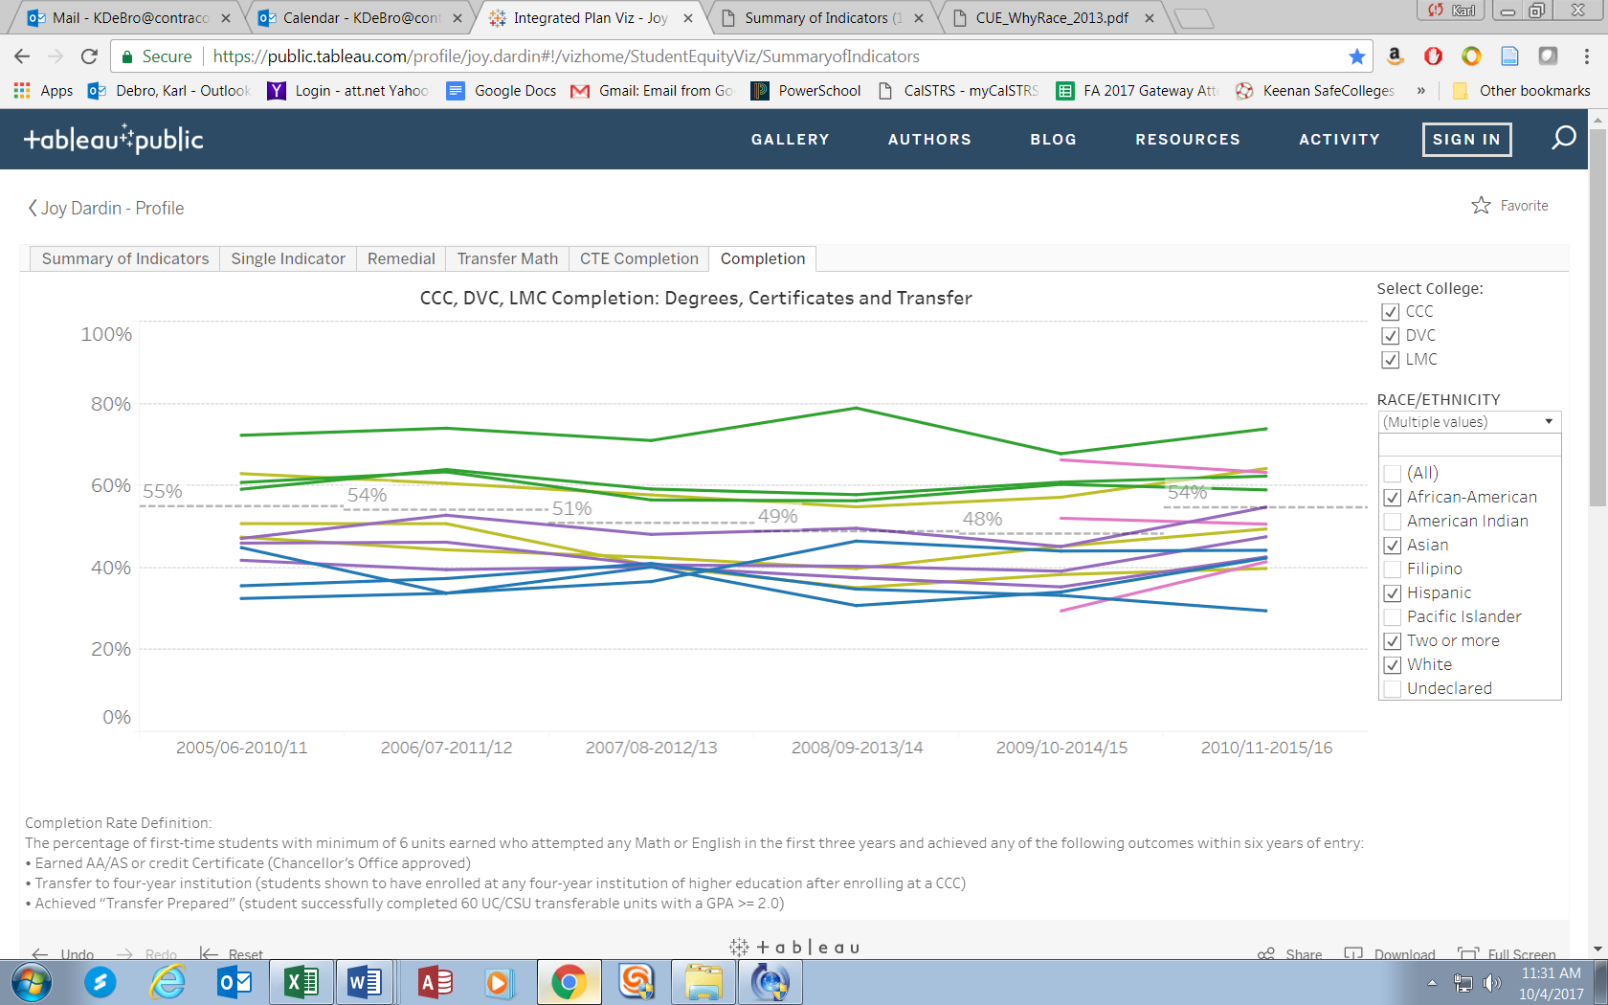

Slide 14
All data downloaded from https://public.tableau.com/profile/joy.dardin#!/vizhome/StudentEquityViz/SummaryofIndicators on October 4, 2017. Karl Debro Student Success Committee Chair 10/4/17

